Slide 1
SKKU Lab Recommendation Service : FindMyLab
Final Presentation
Team J (Last Lap) 김현진 송민석 장민석 조재희
2024-Fall Capstone Design Project

Slide 2
Motivation
“How can we make it easier to find
information about graduate schools?”
Notes:
The rate of graduate school admissions to the Department of Computer Science and Engineering at Sungkyunkwan University has increased significantly over the past 10 years. In this situation, we wanted to plan a service that would allow students to find information about graduate school labs more easily.

Slide 3


Related Work
Limitation of Existing Service
Subjective review
Lab life information
(lack of research information)
Notes:
Existing lab services include PhD.Kim.net and RateMyProfessors.com. These services provided information based on subjective review. They also provided information about lab life, such as reputation and lab atmosphere, rather than information related to research, such as research fields.

Slide 4
Objective
Requirements
1. Providing information based on objective data
2. Providing information related to research
“Lab Recommendation Service
based on Keyword Search”
Notes:
That is why we wanted to provide information that existing services do not provide. We set the concept as providing research-related information based on objective data. Considering user convenience, we decided to plan a keyword search-based lab recommendation service.

Slide 5
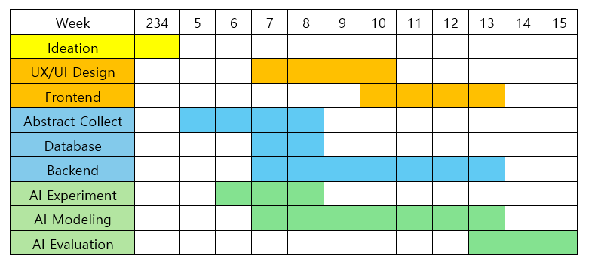
Timeline
Notes:
The progress of the project throughout the semester was as follows.

Slide 6

Role of each member
MinSeok Jang
HyunJin Kim
MinSeok Song
JaeHee Jo
UX/UI
Front-End
Abstract Extract
Back-End
AI Modeling
Notes:
The roles of each team member are as follows. Jang Min-seok and Kim Hyun-jin are focusing on design and frontend, Song Min-seok is handling the backend, and Jo Jae-hee is leading the AI modeling.

Slide 7
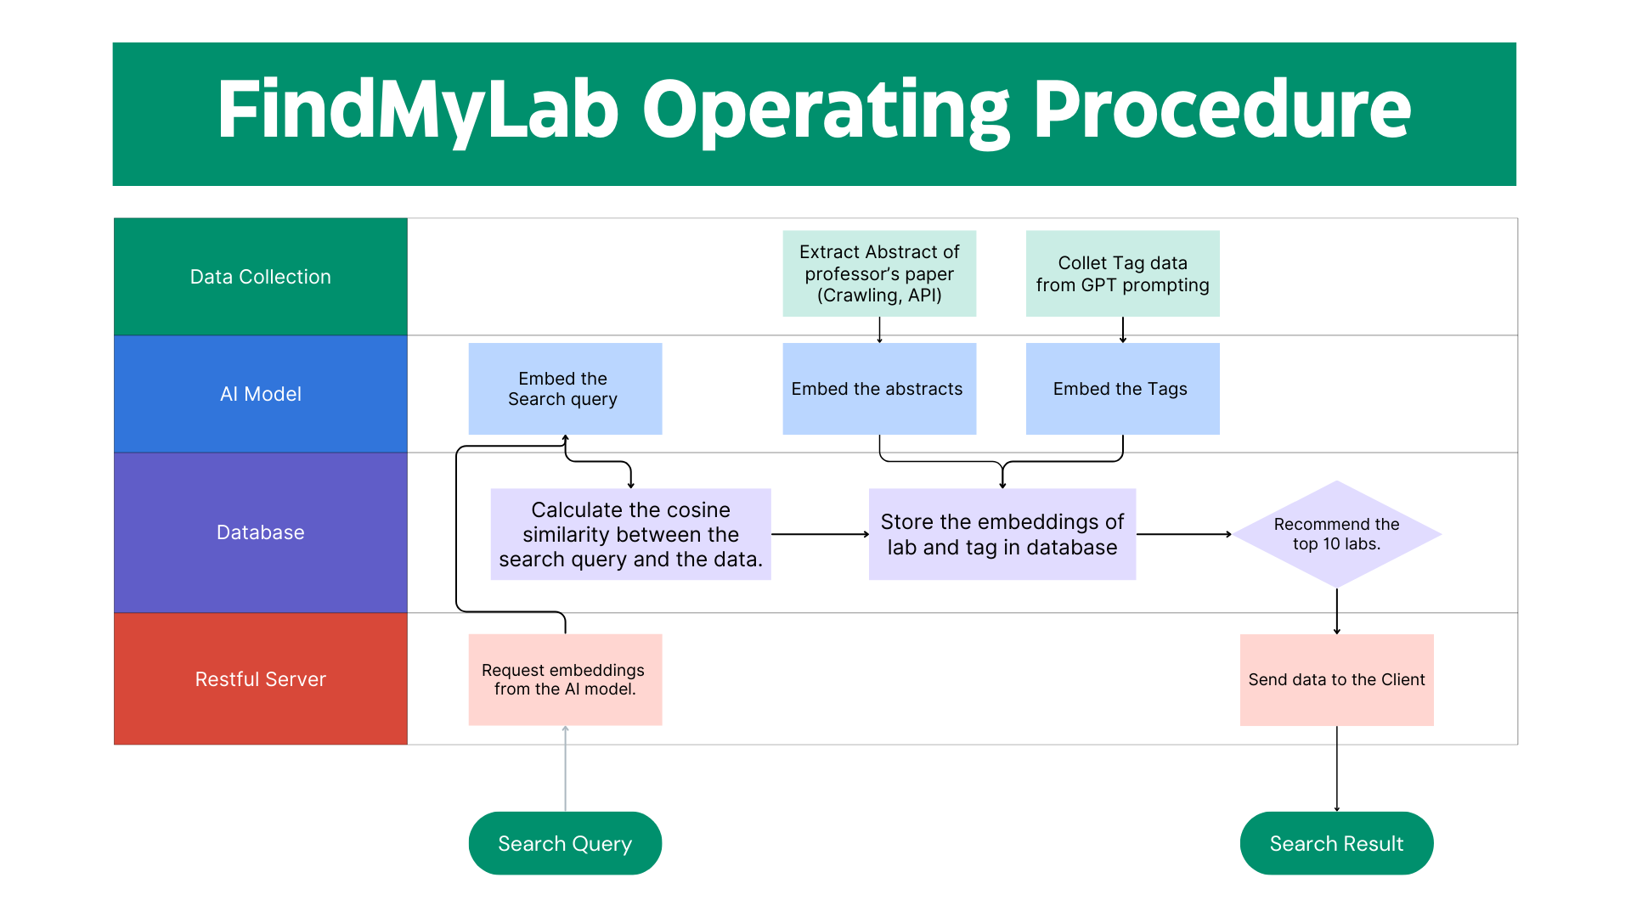
Overall Dataflow
Notes:
The overall dataflow is as follows. First, when a search query is entered, we request embedding from the AI ​​model. Then, we calculate the cosine similarity between the search query and the data in the database. Then, we store the lab and tag embedding in the database. We send information about the top 10 recommended labs to the client. For this process, we collect tag data from the pre-blinded abstract and GPT prompting and embed the abstract and tags in the AI ​​model.

Slide 8



Final Design
Frontend
Backend
Notes:
We chose React for web development for maintainability and scalability. PostgreSQL was used to store embedding and lab-related data. PostgreSQL 16 supports storing embedding data in vector format through the pgvector extension and facilitates the calculation of cosine distance between vectors. The backend server that performs API operations was deployed on AWS EC2 using 4tg.micro instances. The server that runs the AI ​​model used a dedicated desktop server where the model was kept in a preloaded state. Search queries were processed by calculating embeddings and transmitting them over the network. When replacing the AI ​​model, we downloaded the model checkpoint in advance to the desktop server so that the model could be rebooted independently.

Slide 9
Implementation: Demo
Demo : 114.200.143.95:3000
Notes:
Searching for a keyword on the main page takes you to the results page. Clicking on a tag takes you to the results page for the tag keyword search, and clicking on each lab box takes you to the lab page. Lab pages provide information on research topic relevance and related labs. Clicking on a related lab takes you back to the lab page.

Slide 10
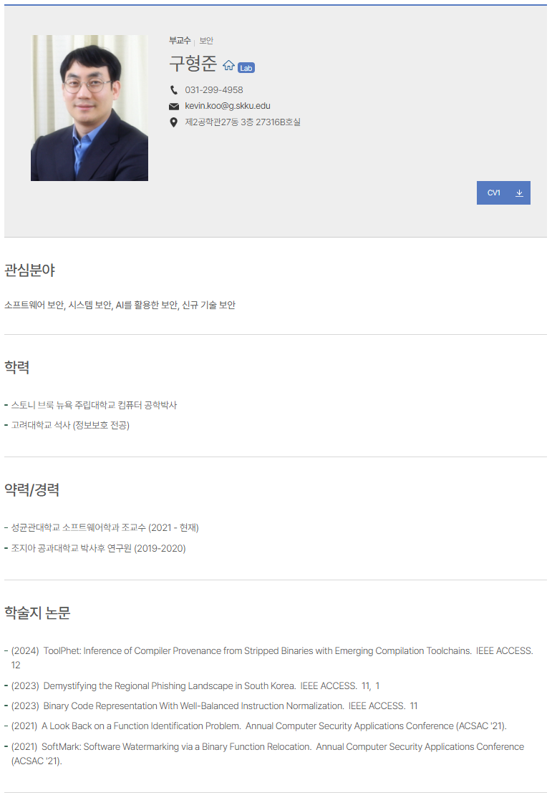

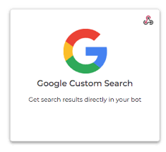

Challenges: Data Collection
Notes:
We faced the following problems while carrying out these tasks. First, we had to collect abstracts of papers to identify the specialty of the lab. First, we used the department website and Google custom search engine to find the URI of the paper. Then, we collected the researcher ID such as ORCID or Scopus ID and searched the entire list of professor's papers. We crawled the abstracts from the collected papers. Second, we organized the tag keywords. Displaying only the lab as the search result does not convey how relevant the keywords are to the paper topic. Therefore, we felt the need for tags. We created tags for each paper through GPT prompt to predefine tags. However, there was a problem that tags with similar meanings were duplicated. The solution to this will be explained later.

Slide 11
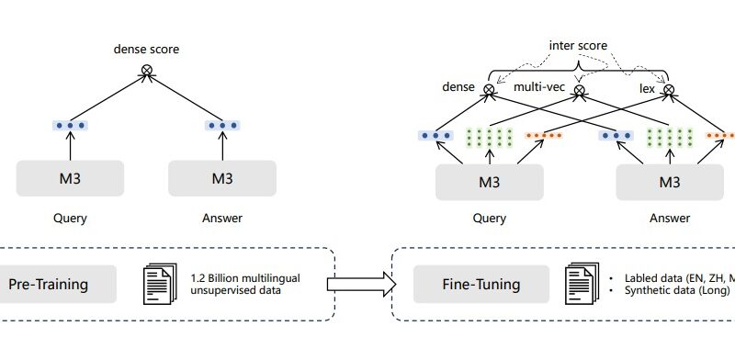
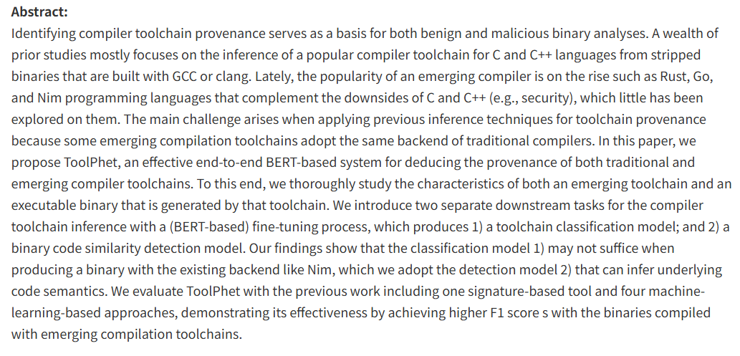
Challenges: AI
BGE-m model : up to 512 tokenize
Actual paper abstract: More than that
Notes:
We used the BGE-m model as the SBERT-based model used for fine-tuning, which can only process up to 512 token input sequences. However, most of the abstracts of the papers exceeded this, and we faced the challenge of having to match the input data format to train the AI ​​model. Second, there was a problem that too many resources were required due to the size of the AI ​​model. It did not simply take a lot of time, but also caused an out-of-memory problem. The solutions to these problems will be explained later.

Slide 12

Algorithms
keywords
Prompt :
read the abstract of the provided research paper and return the field and classification as a single,
combined list of keywords in array format, without any headings or categorization
Language understanding
task-oriented dialogue systems
Abstract of Paper
dialogue research
language generation
Notes:
gpt 프롬프팅을 통해 일차적으로 abstract에 해당하는 키워드를 추출하였다.
각 논문의 초록을 gpt에게 보여주고 해당 논문의 분야를 획득하는 방식으로 약 3500개의 computer science 관련 tag를 얻을 수 있었습니다.
이 키워드는 추후 웹페이지의 태그와 머신러닝 모델 학습 시의 예상되는 사용자 쿼리로 사용되었다.
Keywords corresponding to abstracts were extracted through GPT prompting.
By providing GPT with the abstracts and obtaining the field, approximately 3,500 computer science-related tags were generated.
These keywords were later used as tags for the webpage and as expected user queries during the training of the machine learning model.

Slide 13
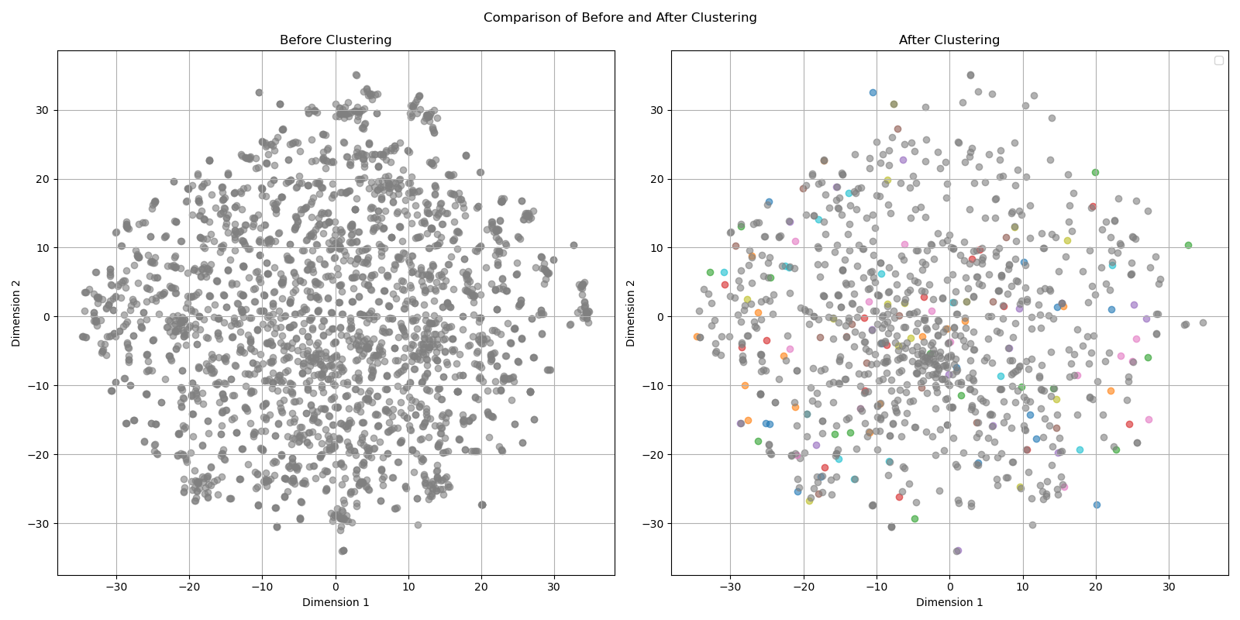
Algorithms
Clustering
epsilon = 0.1
min_samples =2
Notes:
그러나 생성된 단어들 간에 유사한 단어들이 많아 이를 해결하기 위해 tag에 대해 clustering을 실시했습니다. eps = 0.1, min_samples=2로 설정하여 클러스터링하였고, 이때 각 클러스터의 대표 단어는 가장 많은 빈도로 나타난 단어를 사용했습니다. 이 사진은 클러스터링 전후의 단어들의 embedding을 2차원 맵으로 나타낸 것입니다. cluster로 묶인 단어들은 제외하고 cluster와 noise만 표기하였습니다.
However, the extracted words would mostly consist of identical or highly similar keywords. To address this, we applied clustering to the tags.
We set the parameters to epsilon equals 0.1 and min_samples equals 2. For each cluster, the representative word was selected based on the most frequently occurring word within the cluster.
<삭제 해도 됨>
This image visualizes the embeddings of the words in a 2D map before and after clustering. Only clusters and noise are marked, excluding the words grouped within each cluster.

Slide 14
Backend Part – tagging
Clustering Result
Language understanding
Fuzzy logic system
Fuzzy logic
Language learning
Fuzzy logic
Language learning
Medical technology
Reinforcement learning
Medical technology
Reinforcement learning
Healthcare technology
Deep reinforcement learning
Model based reingorcement learning
Notes:
다음은 클러스터링으로 묶은 단어 집합의 예시입니다. 동일한 단어의 축약어나 유사한 의미의 하위분야, 동의어, 매우 비슷한 유사 분야 등이 클러스터로 묶여 나타나는 것을 확인할 수 있었습니다. 이를 통해 최종적으로 cluster와 noise를 합해 약 2300개의 tag를 얻을 수 있었습니다. 이러한 tag들의 embedding을 계산하고 미리 계산해 두었던 교수님의 평균 embedding과 비교하여 교수님마다 tag를 작성할 수 있었습니다
Here are some examples of the clustered tag sets. We observed that subfields with similar meanings were grouped into clusters. Ultimately, after combining the clusters and removing noise, we obtained approximately 2,300 final tags. By calculating the embeddings of these tags and comparing them with the precomputed embeddings of each professor, we were able to generate specific tags for each professor.

Slide 15
Dataset
pre-process
CSV → json
NAME | Abstract | Keywords
고영중
고영중
고영중
…
…
{
“query” : key word (expected search query: using extracted keyword from abstract ),
“pos”: [source abstract]
}
Notes:
다음은 데이터셋 구성입니다. 모델의 학습을 위해 기존에 name, abstract, keywords의 컬럼으로 이루어져 있던 CSV파일에서 검색어가 될 수 있는 keywords열을 query로, 그것의 source abstract를 pos로 두는 json 파일을 먼저 구성한다.
The next is used dataset. To prepare for model training, construct a JSON file from the existing CSV file. Use the keywords column as the query and its corresponding abstract as the pos in the JSON file.

Slide 16
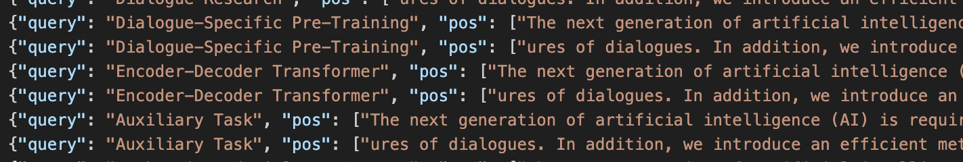
Dataset
pre-process
512 tokenize
{ “query” : key word A, “pos”: [source abstract A-1]}
{ “query” : key word A, “pos”: [next source abstract A-2]}
{ “query” : key word B, “pos”: [source abstract B-1]}
{ “query” : key word B, “pos”: [next source abstract B-2] }
total: 18536
Notes:
모델이 수용하는 문장의 길이가 512이므로 1000~1500자 정도 되는 abstract를 512만큼 잘라서 같은 키워드에 연결하는 방식으로 전처리를 수행하였다.
즉 키워드 A의 Positive abstract A를 A1, A2, A3로 나누어서 사용한 것이다. 이렇게 하면 abstract의 손실을 최대한 막을 수 있을 것이라고 생각했다.
최종 적으로 약 5000개 정도였던 데이터가 18536개가 되었다.
Since the model accepts sentences up to a length of 512, abstracts ranging from 1000 to 1500 characters were split into chunks and linked to the same keyword.
In other words, the positive abstract for keyword A was divided into A1, A2, and A3.
This approach was intended to minimize the loss of abstract information. As a result, the dataset, initially consisting of about 5,000 entries, expanded to 18,536 entries.

Slide 17
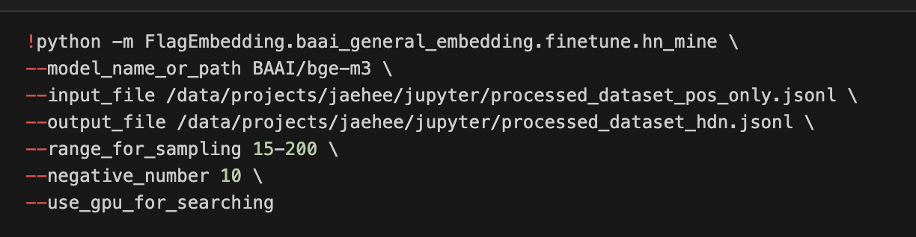
Dataset
pre-process
only pos json →hard negative mining
Notes:
학습을 위해서는 hard negative가 필요하기 때문에 FlagEmbedding의 hardnegative minin을 이용하여 hard negative를 추출하였다.
range_for_sampling는 네거티브를 샘플링할 범위이다. 예를 들어, 14-200은 상위142위부터 200위의 문서 중에서 negative_number만큼의 네거티브를 샘플링한다는 의미입니다.
네거티브의 난이도를 낮추기 위해 더 큰 값을 설정할 수 있습니다. 예를 상위 60-300위 문서에서 네거티브를 샘플링하려면 60-300으로 설정할 수 있습니다.
For training, hard negatives are necessary, so we used the hard negative mining method from FlagEmbedding.
The range_for_sampling parameter defines the range from which negatives will be sampled.
For example, a range of 15-200 means that negatives are sampled from documents ranked between 15th and 200th, selecting a number of negatives specified by negative_number.
To lower the difficulty of negatives, you can set a larger range.

Slide 18
Dataset
pre-process
result of hard negative mining
{ “query” : key word A, “pos”: [source abstract A-1], “neg”:[mining result 1], ... ,[mining result N] }
{ “query” : key word A, “pos”: [next source abstract A-2] , “neg”:[mining result 1], ... ,[mining result N] }
{ “query” : key word B, “pos”: [source abstract B-1] , “neg”:[mining result 1], ... ,[mining result N] }
{ “query” : key word B, “pos”: [next source abstract B-2] , “neg”:[mining result 1], ... ,[mining result N] }
Notes:
위의 결과는 negative mining의 결과입니다.
"query"는 검색어, "pos"는 해당 검색어와 연관된 문서들이 포함된 리스트, "neg"는 해당 검색어와 연관되지 않은 문서들이 포함된 리스트가 됩니다.
The above results are the outcome of negative mining.
The "query" represents the search keyword, "pos" is a list of documents associated with the keyword, and "neg" is a list of documents unrelated to the keyword.

Slide 19
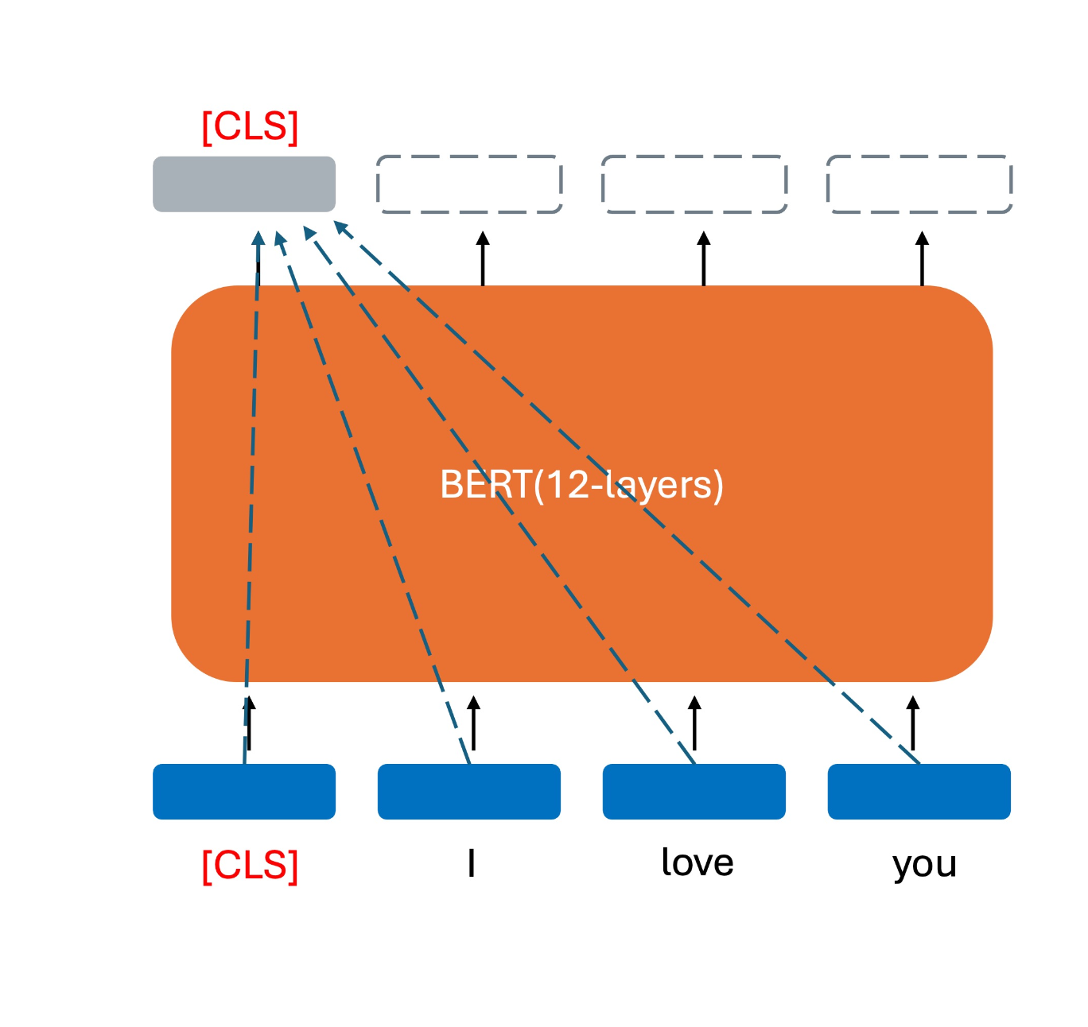
Model
SBERT
(u; v; |u-v|)
u
v
pooling
pooling
BERT
BERT
Sentence A
Sentence B
Notes:
문장 임베딩을 생성하기 위해 BERT의 향상되 버전인 SBERT를 사용하였다.
The original BERT model is a bidirectional model based on a deep stack of Transformer encoders.
However, BERT requires both sentences to pass through a single Transformer together.
Since BERT classifies the relationship between two sentences by processing them simultaneously,
it is too time-consuming.so, we used SBERT, which computes embeddings for each sentence separately.

Slide 20
Model
Model Change
! issue of out of memory
→ changed to small model
SBERT-base-nli-v2
→
BAAI/bge-small-en-v1.5
Notes:
모델에 있어서는 사이즈 문제가 있었다. 기존 모델이 너무 커서 Out of memory 문제가 발생하였다.
우리는 multi-lingual도 아니고 영어 데이터만 다루기 때문에 가장 작은 SBERT 모델인 BAAI의 bge-small-en-v1.5의 가장 최신 버전을 파인튜닝 하였다.
For the model we have size problem. The original model first we decided to use was too large, causing out-of-memory issues.
Since we are not dealing with multi-lingual data and only working with English data, we fine-tuned the smallest SBERT model, the latest version of BAAI's bge-small-en-v1.5.

Slide 21
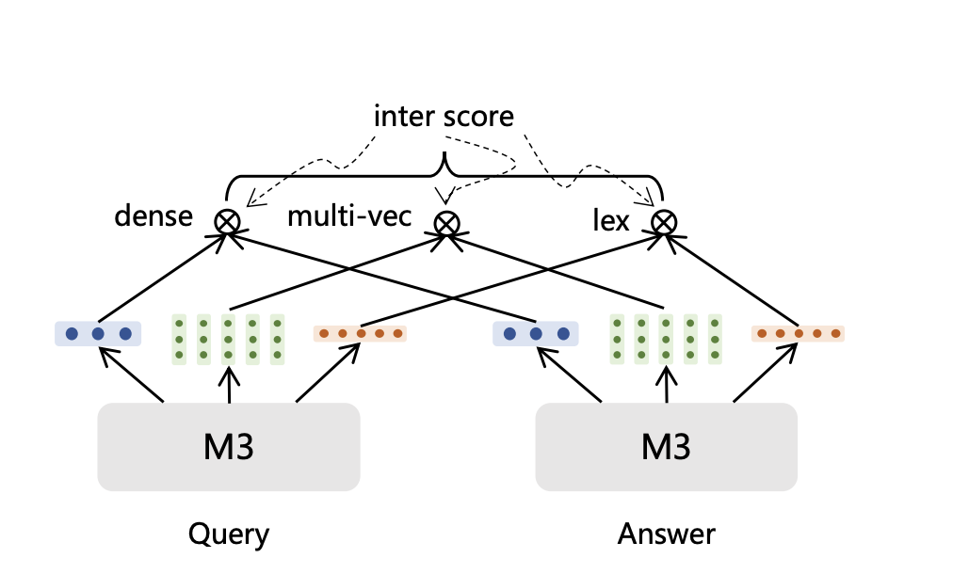
Model
Architecture
Notes:
Additionally, this model is trained to perform hybrid retrieval by integrating three functionalities: dense retrieval (문맥 정보와 의미를 잘 캡처), lexical retrieval(구체적인 단어 매칭이나 어휘 수준의 정보), and multi-vector retrieval(dense 표현이 놓칠 수 있는 디테일한 정보).
In this process, the prediction scores are summed as follows:

Slide 22
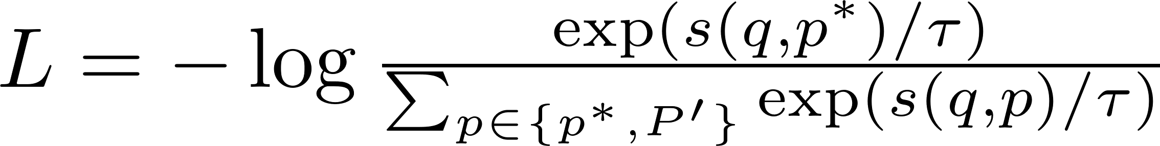
Model
Loss
InfoNCE loss
contrastive learning to distinguish between positive and negative samples
Notes:
모델의 논문에 따르면 Self- knowledge distillation기법을 사용하여 positive samples과 negative samples 구분할 수 있도록 infoNCE loss로 학습된다
According to the model's paper, it uses a self-knowledge distillation technique to distinguish between positive and negative samples. The model is trained using InfoNCE loss, represented by the following formula.

Slide 23
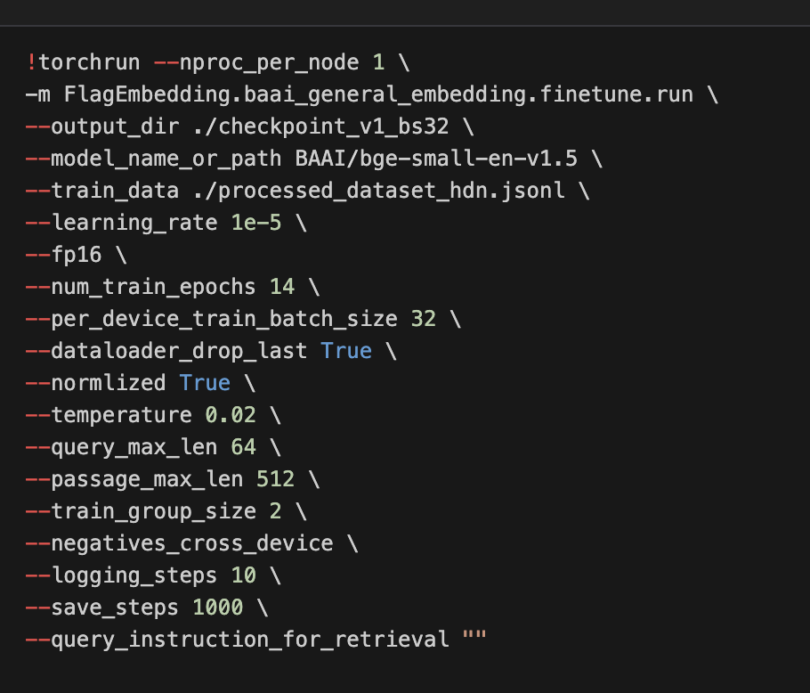
Model
Hyperparameter
batch size: 32
epoch: 14
Notes:
fintune할 때 배치 사이즈는 32로 두고 epoch를 14로 두었다. 그 이상 했을 경우에는 training loss가 더이상 낮아지지 않았고 오버피팅이 우려되었다.
During fine-tuning, the batch size was 32, and the number of epochs was set to 14. Beyond this point, the training loss did not decrease further, and there were concerns about overfitting.

Slide 24
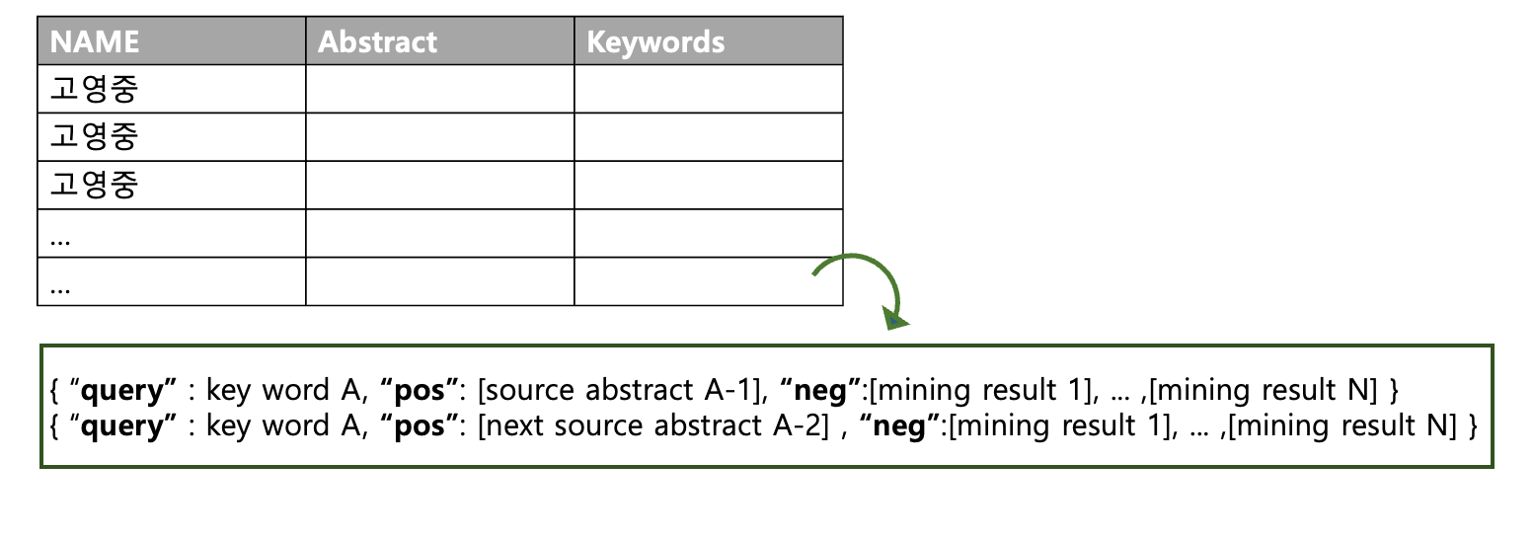
Model
<input>
<out put>
0.286
0.792
-0.177
-0.107
0.109
…
-0.542
0.349
-0.271
-0.286
0.177
…
prof_name =
or
keywords =
Notes:
The input is crawled data file containing professor name, abstracts and the keywords and the output would be the embedding of professor or keywords which are used to rank and find the
professor.

Slide 25

Model Evaluation
mAP@K
< result >
 | finetune | base
K = 3 | 0.48 | 0.45
K = 5 | 0.51 | 0.48
K = 7 | 0.52 | 0.49
Notes:
We used mAP (Mean Average Precision),which takes
the order of recommendations into account to quantitatively evaluate our model.
The formula for mAP is as follows:
as you can see our shows high score
---
Where U represents the number of users, and the AP value is calculated for
each user. The mean Average Precision (mAP) is obtained by dividing the sum
of AP values by the number of users, providing the average precision across all
users. Below is a comparison with the baseline model:

Slide 26
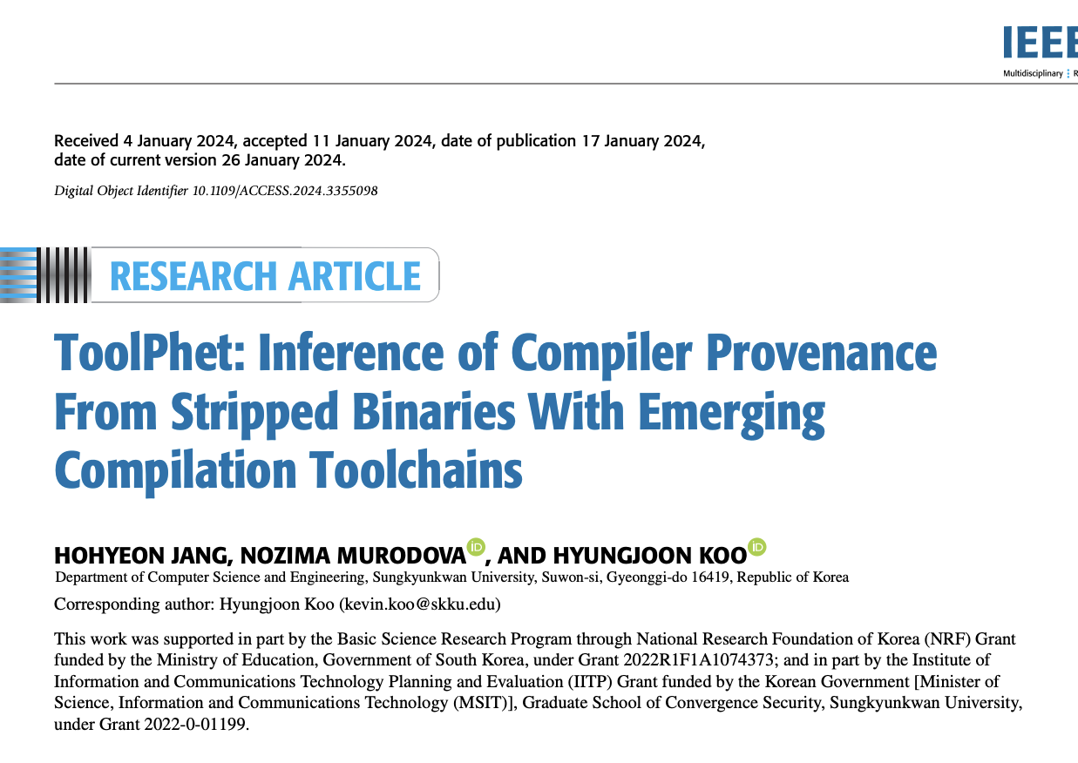
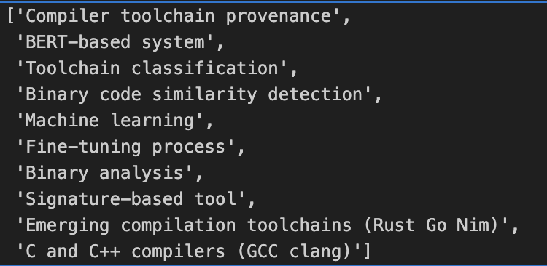
Model Evaluation
Experiments
search keywords
Notes:
다음은 정성적 실험 내용이다. 구형준 교수님이 검색 결과로 나올 수 있도록 keywords를 구성한 후에 해당 키워드로부터 구형준 교수님을 검색할 수 있는지 확인해 보았다.
The following describes the qualitative experiment. Keywords were constructed to ensure that Professor Hyungjoon Koo could appear in the search results, and it was verified whether the model can find Professor Hyungjoon in real.

Slide 27
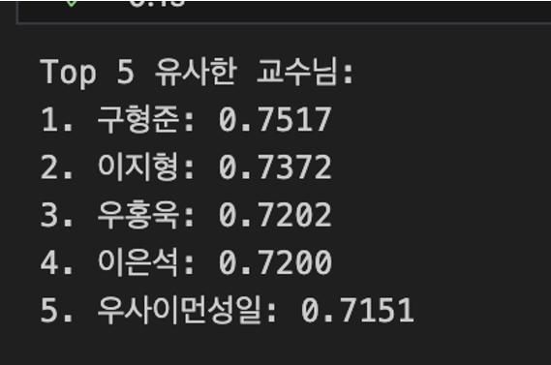
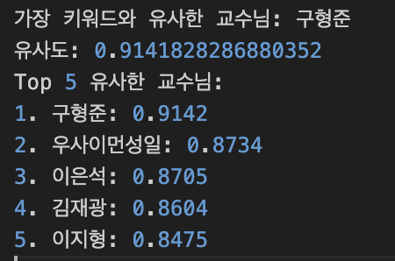
Model Evaluation
Experiments
<before>
<after>
0.01
0.04
Notes:
좌측에 있는 결과가 파인튜닝 전이고 우측에 있는 표가 파인튜닝 후이다. 더 높은 확률로 구형준 교수님을 검색하고 있었고 다른 교수님들과의 차이를 좀더 늘릴 수 있었다.
The left are before fine-tuning, while right shows the results after fine-tuning. The fine-tuned model was able to identify Professor Koo Hyung-Jun with a higher probability, and the distinction from other professors became more greater.

Slide 28
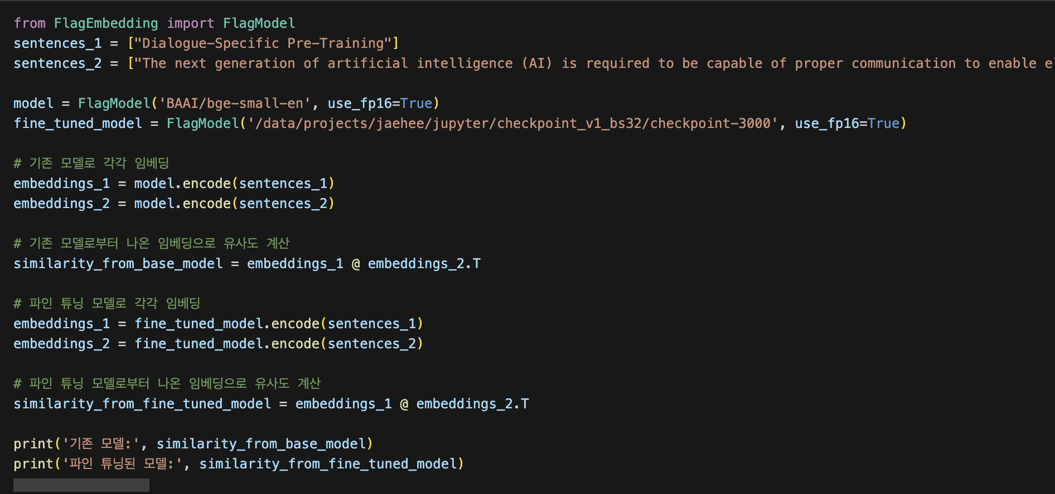
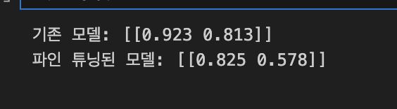
Model Evaluation
Experiments
Notes:
기존 모델과 파인 튜닝 된 모델이 낸 결과를 비교해 보았다. negative pair와 positive pair간의 차가 파인튜닝 된 모델에서 더 높게 나타남을 확인할 수 있었다.
We compared the results of the original model with the fine-tuned model. It was observed that the difference between negative pairs and positive pairs was greater in the fine-tuned model.

Slide 29
Limitations
only targeted at the Department of Computer Science and Engineering at SKKU
lack of real-world evaluation ( user test )
lack of User-Friendly Features
Notes:
Summary of Limitations:
we have some limitations
Focus on the Department of Computer Science and Engineering at SKKU: The project was constrained to targeting only the Department of CSE at Sungkyunkwan University (SKKU). Many students, may seek information from broader fields, but the service could not accommodate this due to practical limitations.
Lack of Real-World Evaluation (User Testing): Second, the project lacked comprehensive user testing, leaving uncertainty about user satisfaction.
Lack of User-Friendly Features: The service was limited to keyword-based research lab searches and recommendations. It did not offer additional features that would enhance user convenience.

Slide 30
Conclusion
helping students find labs that match their interests
expanding to other departments and universities
Notes:
Our team identified the difficulty students face in finding labs aligned with their research interests when entering graduate school and developed the FindMyLab service to address this issue. The service focuses on helping students find labs that match their interests, rather than forcing them to adjust to existing lab research fields, thereby improving accessibility to graduate school opportunities.
(2) Additionally, the service can be expanded to other departments and universities, helping students explore various fields and pursue graduate studies across a broader range of disciplines.

Slide 31
References
1. Yongwoo Kim, Daeyoung Kim, Hyunhee Seo, Young-Min Kim. Content- based Korean journal recommendation system using Sentence BERT. Journal of Intelligence and Information Systems, Volume 29 Issue 3, Pages.37–55.
https://doi.org/10.13088/jiis.2023.29.3.037
2. 빈이름. (2023, March 20). Sentence-BERT: Sentence Embeddings Using Siamese BERT-Networks.
의미있는블로그. https://all-the-meaning.tistory.com/9
3. LLM+추천시스템 Large Language Models Meet Collaborative Filtering: An EfficientAll-Round LLM-Based Recommender System. (2024, July 19). Anything. https://wigo.tistory.com/entry/LLM
4. J, H. (2023, May 6). [SBERT] 키워드 추출 기반 유사 메뉴 검색 서비스. ’s Tory.
https://hjkim5004.tistory.com/122
5. 테디노트. (2024, August 17). 02. FAISS. <랭체인LangChain 노트> - LangChain 한국어 튜토리얼. https://wikidocs.net/234014

Slide 32
Q & A

